Slide 1
Immigration and the Garden as a Workshop:
Resettling and Cultural Interaction of Bulgarian Immigrant Groups to Hungary (late 19th – early 20th c.)
Nikolai Vukov
Associate Professor, Ph.D.
Institute of Ethnology and Folklore Studies with Ethnographic Museum –
Bulgarian Academy of Sciences

Slide 2
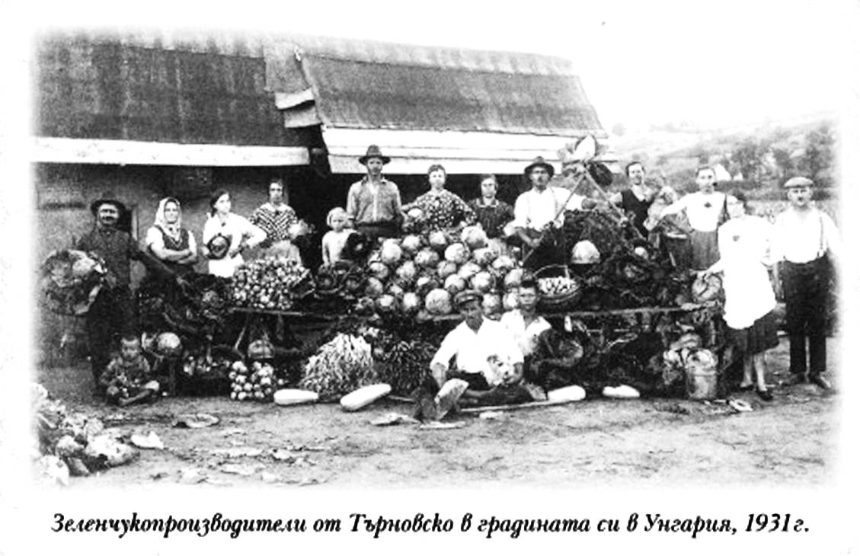

Slide 3
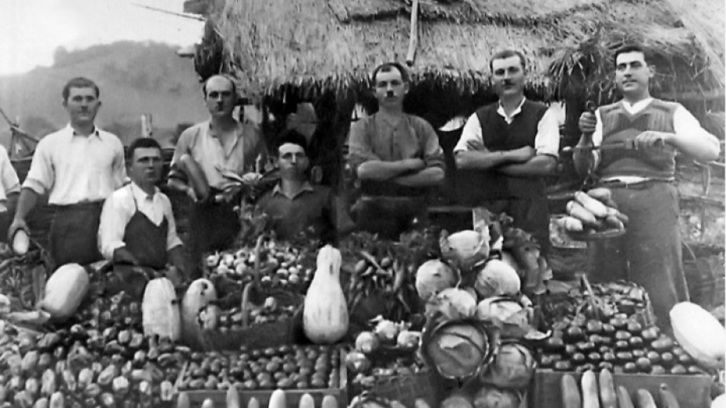

Slide 4
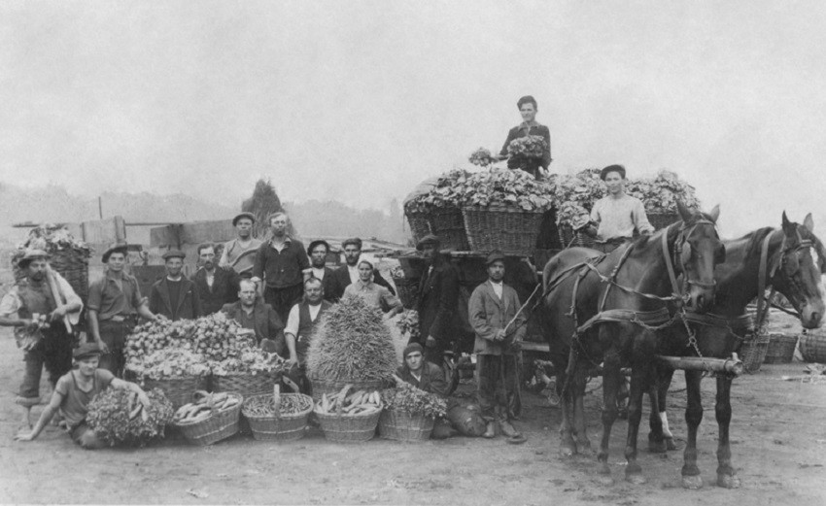

Slide 5
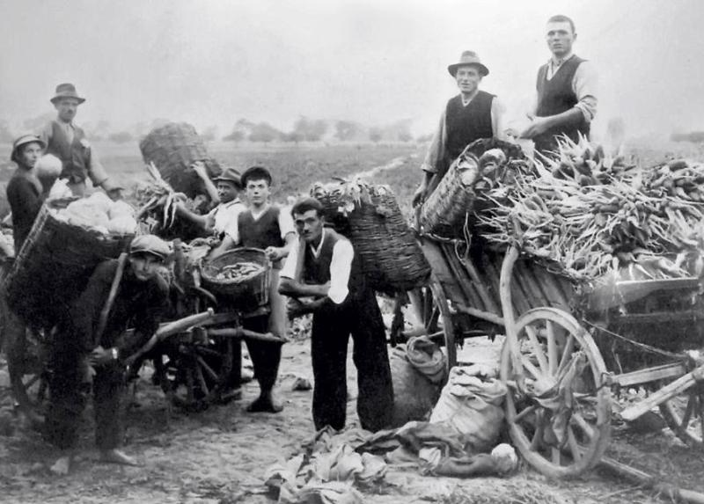

Slide 6
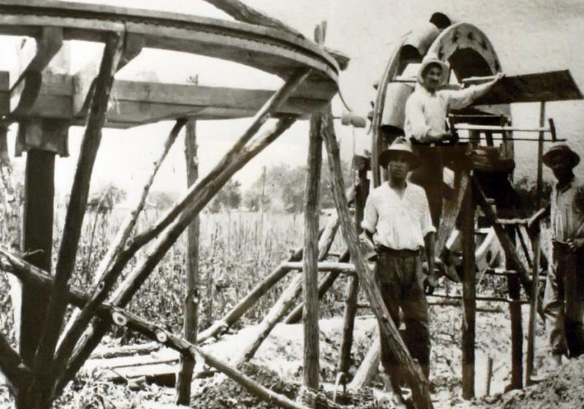

Slide 7
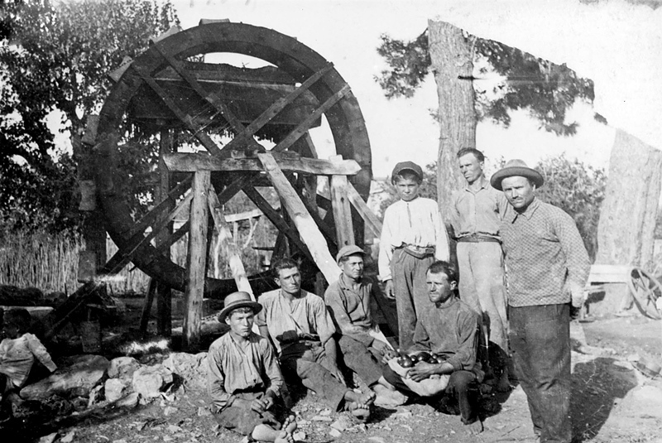

Slide 8
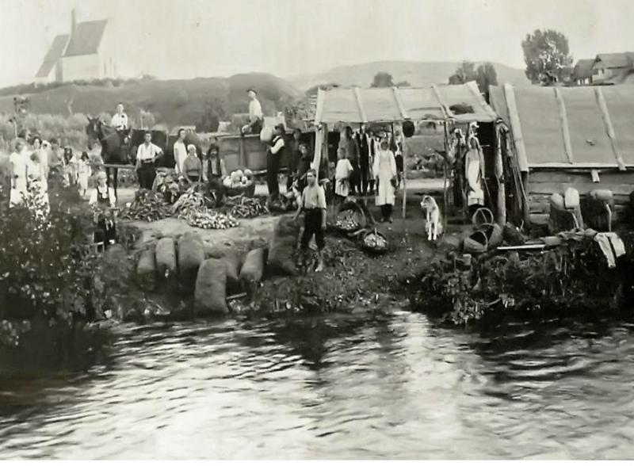

Slide 9
Historical Waves of Bulgarian Immigration to Hungary
Bulgarian Gardening as a Central European Phenomenon
Economic Migration
Conditions of Resettling, Seasonal Pattern
The Garden as a Workshop
Institutions and Community Development
Gardeners and Social Change – Modernizing Impact on Horticulture, Nutrition, Community Organization
Multiple Modernities
Adjustment and Interactions with the Host Society
Links with the Lands of Origin and Transfer of Social Experience from Hungary
Development of the Gardeners’ Community during the 20th century

Slide 10
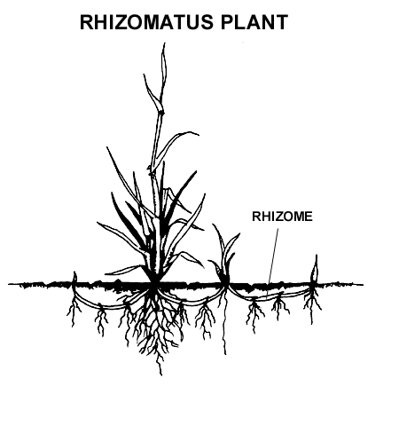
Immigration as rhizomatic experience

